Slide 1

6th Grade Math
Unit 10, Lesson 7 Measures of Center and Spread Volume 2, pg. 231

Slide 2


Benchmark
MA.6.DP.1.6
Given a real-world scenario, determine and describe how changes in data values impact measures of center and variation.
volume 2, pg. 231

Slide 3
Integrated Mathematical Thinking and Reasoning Standards
MA.K12.MTR.2.1 Demonstrate understanding by representing problems in multiple ways.
MA.K12.MTR.7.1 Apply mathematics to real-world contexts.
volume 2, pg. 231

Slide 4

Learning Target
I can determine which measures of center and variation best describe a distribution.
volume 2, pg. 231

Slide 5

Warm-Up
volume 2, pg. 231

Slide 6
10.7.1 Warm-Up: Notice and Wonder
The dot plot, histogram, and box plot summarize the hours of battery life for $26$ cell phones that are constantly streaming videos.
Battery Life (in hours)
Battery Life (in hours)
What do you notice?
What do you wonder?
Battery Life (in hours)
volume 2, pg. 231

Slide 7

Exploration
volume 2, pg. 232

Slide 8

10.7.2 Exploration: Measures of Center
Consider the histogram of the lengths of female sharks.
Shark Length
Frequency
Length (in inches)
volume 2, pg. 232

Slide 9
Describe the shape of the histogram.
Circle the value on the horizontal axis of the graph that shows the approximate location of the median of the data.
Draw an arrow (↑) on the graph to indicate the approximate location of the mean of the data.
volume 2, pg. 232

Slide 10


Compare your answers to B and C with your partner’s answers. Discuss your reasoning and, if necessary, make changes.
The mean and the median of this histogram are located between $15−15.5$. Discuss with your partner which measure most accurately describes the center of the histogram. Summarize your discussion.
In a symmetrical graph, the mean and the median are located in the middle of the graph, approximately in the same location.
In a symmetrical graph with no outliers, the __________ is the preferred measure of center and the ___________ is the preferred measure of variation to describe the distribution.
volume 2, pg. 232

Slide 11
The histogram displays the number of points per game scored by a college basketball player during the 2008 season.
Describe the shape of the histogram.
Circle the value on the horizontal axis of the graph that shows the approximate location of the median of this data.
Draw an arrow (↑) on the graph to indicate the approximate location of the mean of the data.
2008 Points per Game
Frequency
Points
volume 2, pg. 233

Slide 12
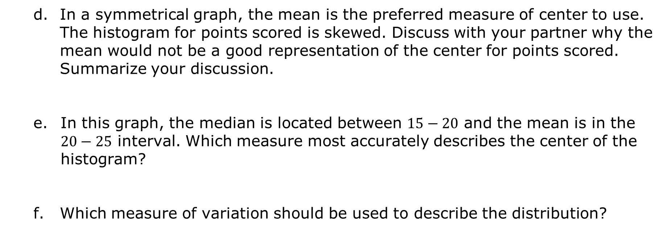
In a symmetrical graph, the mean is the preferred measure of center to use. The histogram for points scored is skewed. Discuss with your partner why the mean would not be a good representation of the center for points scored. Summarize your discussion.
In this graph, the median is located between $15−20$ and the mean is in the $20−25$ interval. Which measure most accurately describes the center of the histogram?
Which measure of variation should be used to describe the distribution?
In a skewed graph or a graph with outliers, the ____________ is the preferred measure of center and the _____________ is the preferred measure of variation to describe the distribution.
volume 2, pg. 233

Slide 13

Try It
volume 2, pg. 234

Slide 14

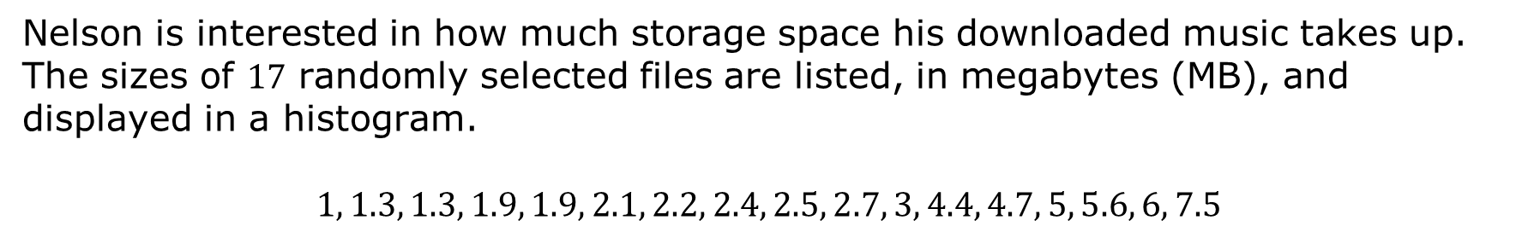
10.7.3 Try It: Measures of Center
Nelson is interested in how much storage space his downloaded music takes up. The sizes of $17$ randomly selected files are listed, in megabytes (MB), and displayed in a histogram.
$$1, 1.3, 1.3, 1.9, 1.9, 2.1, 2.2, 2.4, 2.5, 2.7, 3, 4.4, 4.7, 5, 5.6, 6, 7.5$$
Song Size
Frequency
1 2.3 3.6 4.9 6.2 7.5 8.8
Size (in MB)
volume 2, pg. 234

Slide 15
Describe the shape of the histogram.
Which measure of center best describes the center of the histogram?
Explain your choice of center.
volume 2, pg. 234

Slide 16

Your Turn
volume 2, pg. 234

Slide 17
10.7.4 Your Turn!
Determine which measures of center and variation best describe each data set.
volume 2, pg. 234

Slide 18
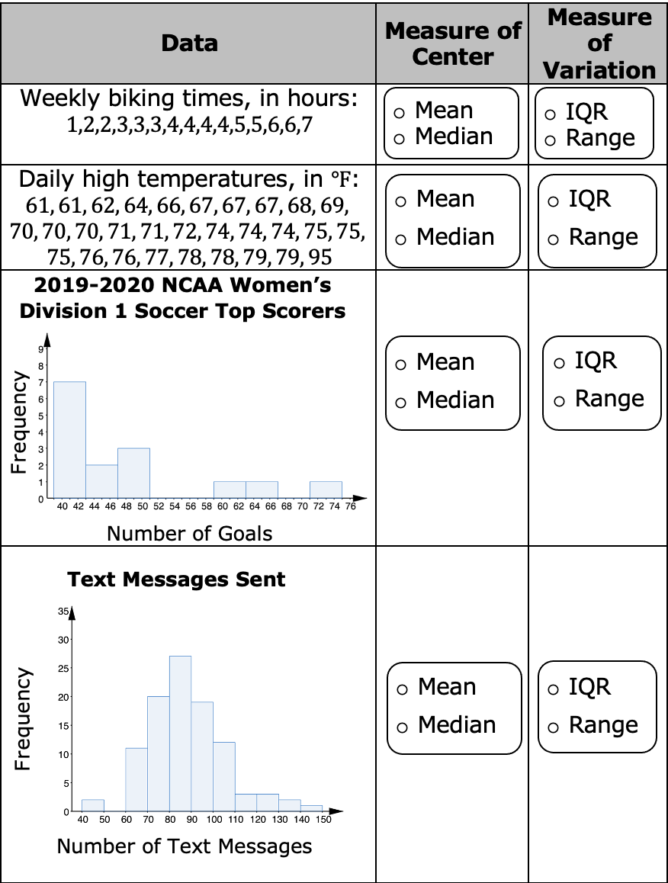
volume 2, pg. 234

Slide 19

Wrap-Up
volume 2, pg. 235

Slide 20
10.7.5 Wrap-Up: Reflection
Draw an X on the line to indicate where your current learning is related to each target.
I can determine which measures of center and variation best describe a distribution.
I need help. I can’t get started. | I’m getting there, but I need more practice. | I understand this, and I feel confident.
volume 2, pg. 235

